Slide 1
Events and Event Handlers
Deekshith

Slide 2
Events and Event Handlers
React uses events to capture user interactions like clicks, keystrokes, or mouse movements etc.

Slide 3
Events and Event Handlers
React uses events to capture user interactions like clicks, keystrokes, or mouse movements etc.
In React, events are named using camelCase (e.g., onClick, onChange, onMouseEnter).

Slide 4
Events and Event Handlers
React uses events to capture user interactions like clicks, keystrokes, or mouse movements etc.
In React, events are named using camelCase (e.g., onClick, onChange, onMouseEnter).
Event handling in React follows a similar pattern to standard JavaScript event handling but with some key differences, such as using synthetic events for cross-browser compatibility and providing consistent event handling across different elements and browsers.

Slide 5
What is Synthetic Event?
A synthetic event in React is a cross-browser wrapper around the native DOM events. It provides a consistent and normalized interface to handle events across different browsers, ensuring that your React code works in a uniform way, regardless of the browser’s implementation.

Slide 6
Synthetic Event Common Attributes:
boolean bubbles
boolean cancelable
DOMEventTarget currentTarget
boolean defaultPrevented
number eventPhase
boolean isTrusted
DOMEvent nativeEvent
void preventDefault()
boolean isDefaultPrevented()
void stopPropagation()
boolean isPropagationStopped()
void persist()
DOMEventTarget target
number timeStamp
string type

Slide 7
Events in React.JS:
onClick: Triggered when an element is clicked.
onChange: Triggered when the value of an input element changes.
onSubmit: Triggered when a form is submitted.
onMouseEnter: Triggered when the mouse pointer enters an element.
onMouseLeave: Triggered when the mouse pointer leaves an element.

Slide 8
Events in React.JS:
6. onKeyDown: Triggered when a key is pressed down.
7. onKeyUp: Triggered when a key is released.
8. onFocus: Triggered when an element receives focus.
9. onBlur: Triggered when an element loses focus.
10. onInput: Triggered when the value of an input element is changed (similar to onChange)

Slide 9
Event Handlers:
Event Handlers: Functions that are executed in response to specific events.
Have names that start with handle, followed by the name of the event.
export default function Button()
{
function handleClick() {
alert('You clicked me!');
}
return <button onClick={handleClick}>Click me</button>
}

Slide 10
Event propagation:
Event propagation refers to the process of how events propagate or travel through the DOM hierarchy.
Event handlers will also catch events from any children your component might have. We say that an event “bubbles” or “propagates” up the tree: it starts with where the event happened, and then goes up the tree.
In JavaScript, there are two phases of event propagation capturing phase and bubbling phase.

Slide 11

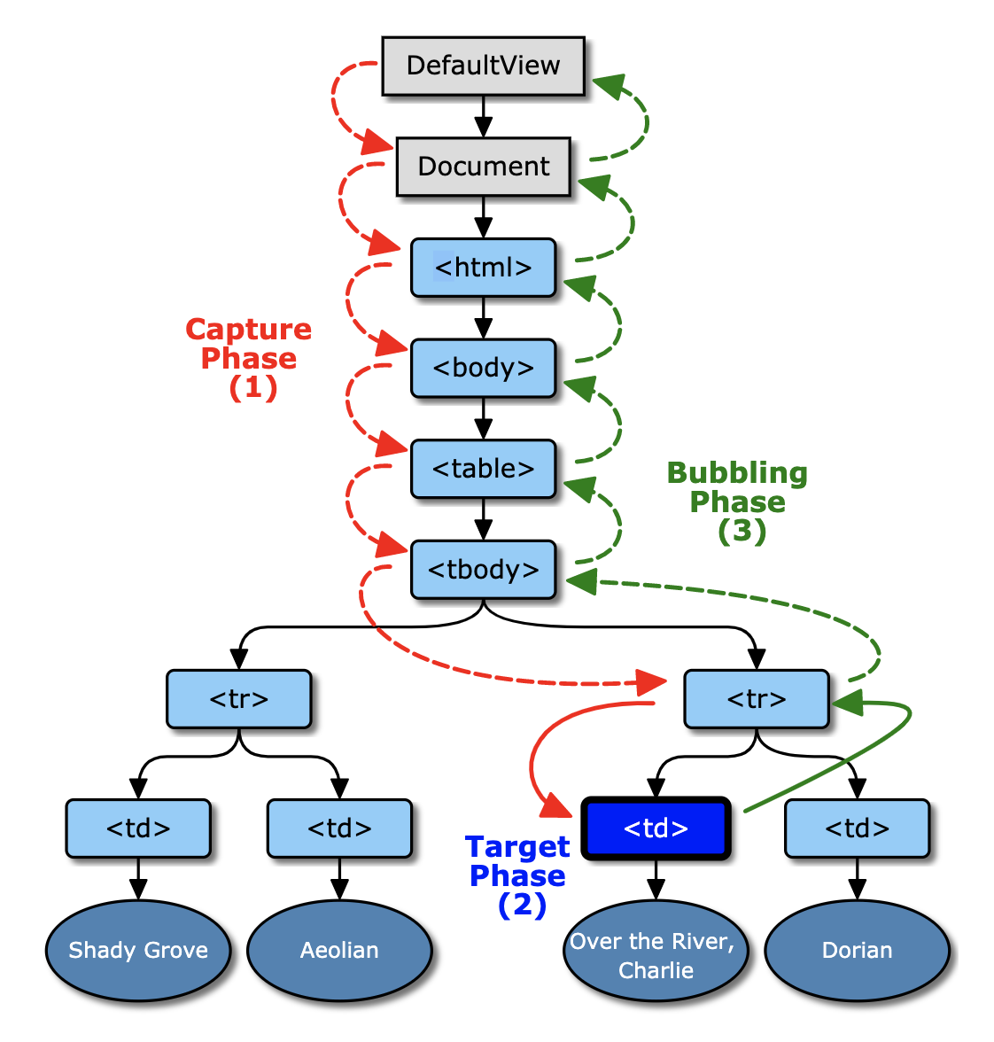
Event propagation:

Slide 12
Preventing default behavior:
Some browser events have default behavior associated with them.
For example, a <form> submit event, which happens when a button inside of it is clicked, will reload the whole page by default.
e.preventDefault() can be called on the event object to stop this from happening.

Slide 13
Thank You
Deekshith

